Slide 1

BUS RESERVATION
INSTITUTE OF ENGINEERING AND TECHNOLOGY,LUCKNOW
By-
SUYASH TRIPATHI
AND
SHOURYA SURYAVANSHI
1

Slide 2
CERTIFICATE
This is to certify that the “Mini Project Report” submitted by Suyash Tripathi (Roll. No – 2100520100159) is work done by him and submitted during the 2023 – 2024 academic year, in partial fulfilment of the requirements for the award of the degree of Bachelor of Technology in Computer Science Engineering at Institute of Engineering and Technology (Sitapur Road, Lucknow, Uttar Pradesh, India
Date: 09th January 2024
Place: Lucknow Dr. Girish Chandra
Head of Department
Mrs. Deepali Awasthi
Course Coordinator
KCS - 554

Slide 3
Table of Contents 1.What is Bus Reservation System? 2.Features of Bus Reservation System Project in C++ 3.Modules of Bus Reservation System 4.Working of Project 4.1.Main Screen: 4.2.Add Bus: 4.3Bus Reservation: 4.4Show: 4.5Buses Available: 4.6Exit: 5.Summary:
3

Slide 4
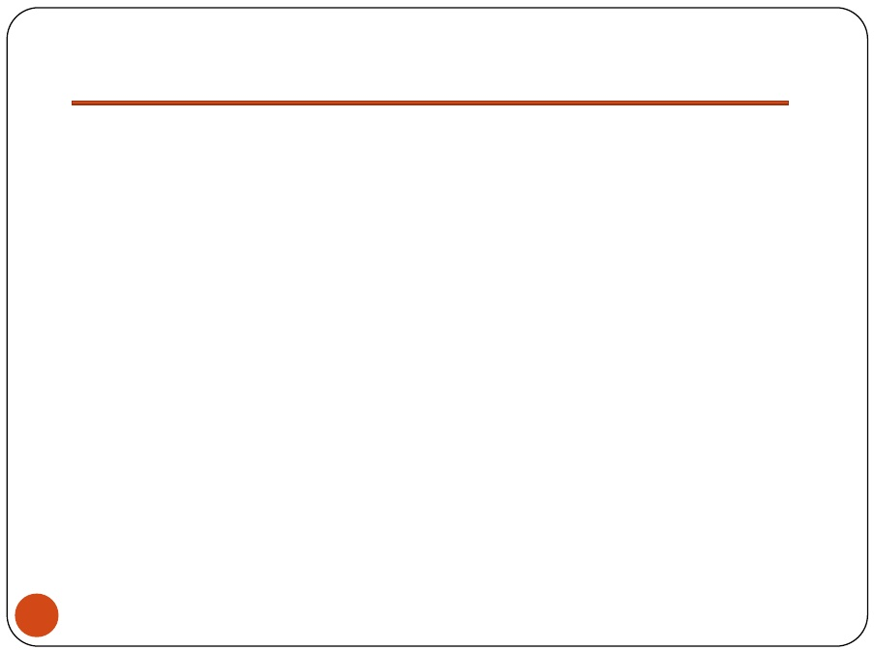
Introduction
What is Bus Reservation System?
As the name suggests Bus Reservation System is software that handles the entire booking data of the Bus. It is fully based on the concept of reserving bus tickets for various destinations. Previously the task of handling the tickets at a time was very difficult, so there was a need for software that can handle all Bus Reservation systems.
Therefore the Bus Reservation System was designed. After the release of this system, the stress and workload of the employee were absolutely finished. It was also time-wasting for the travelers to book a Ticket previously. But now it hardly takes 10 to 15 minutes to book a ticket wherever the passenger is.
4

Slide 5
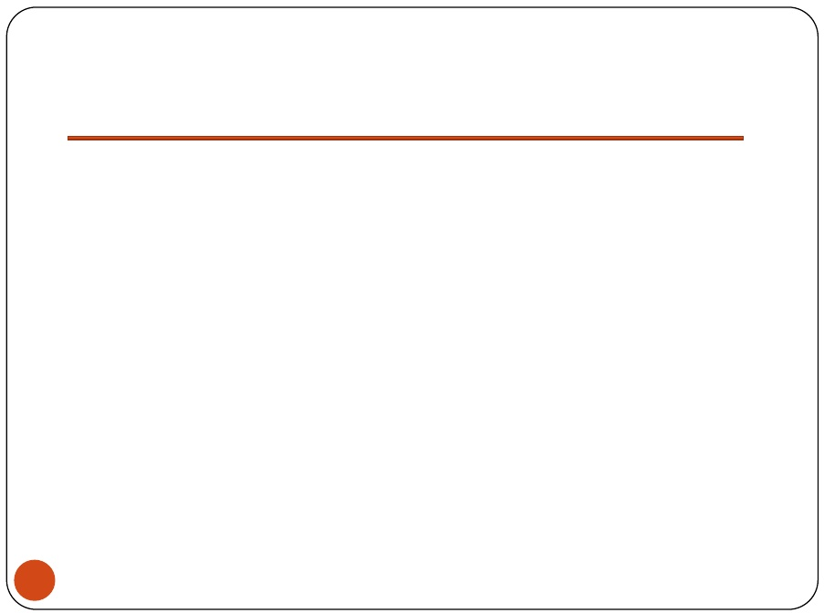
Features of Bus Reservation System Project in C++
There are no admin rights given, anyone can handle this project.
In this project anyone can add buses and do the reservation.
The passenger can book the bus only if bus is available.
Passengers will be able to check the availability of seats of
particular bus, whether seats are reserved or not.
Passengers are able to see the status of available buses.
5

Slide 6
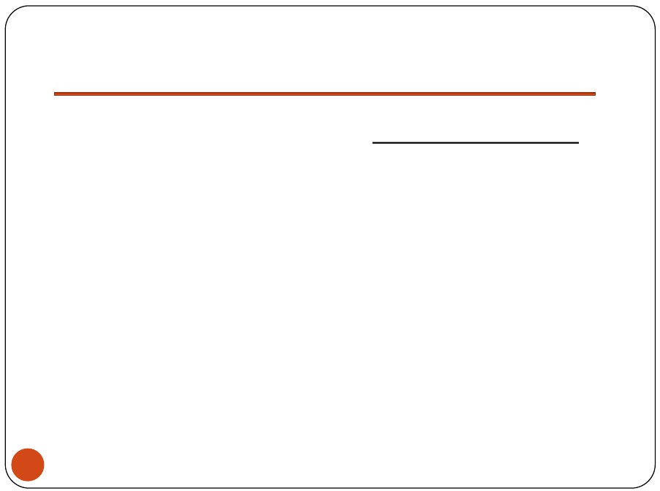
Modules of Bus Reservation System
Add Bus
Modify Bus.
Delete Bus.
Search Bus.
Reserve Bus Seat.
Cancel Booking.
6

Slide 7

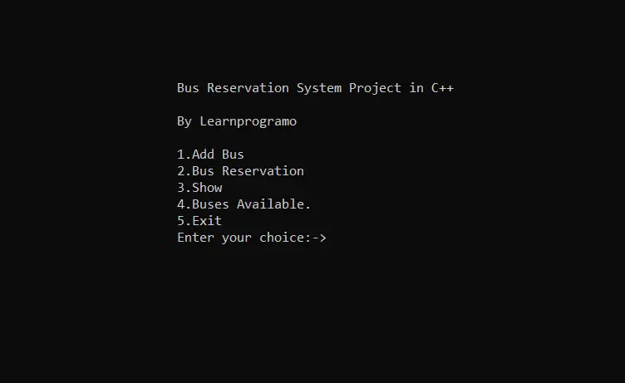
Main Screen:
When you run the project from any compiler or directly clicking on the executable .exe file you’ll see the following screen shown in the picture.
7

Slide 8
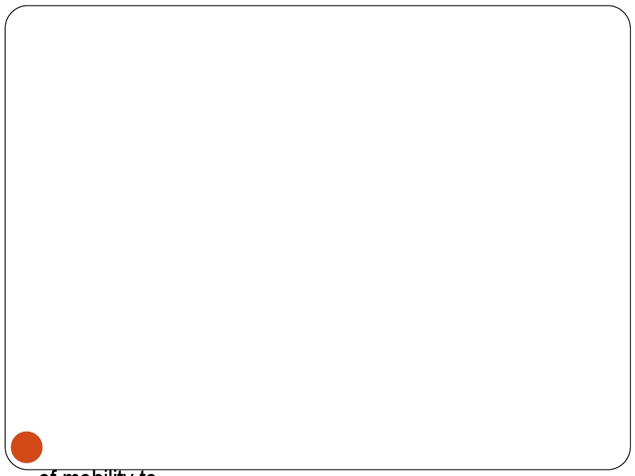
Here, we’ve displayed the menu of Add bus, Bus reservation, Show bus, Buses available, and Exit. If you want to add the new bus which is planned to depart then you should choose the menu as 1. If you’re a passenger and want to reserve the bus seat then choose the menu as 2. The best feature of this project is that you can see which seat is reserved and which seat is not reserved. To see the reservation data you have to choose the menu as 3. If you want to see the data of available buses then choose the menu option as 4. And the 5th menu option is to exit the project. Now we’ll see each and every menu in detail.
7

Slide 9
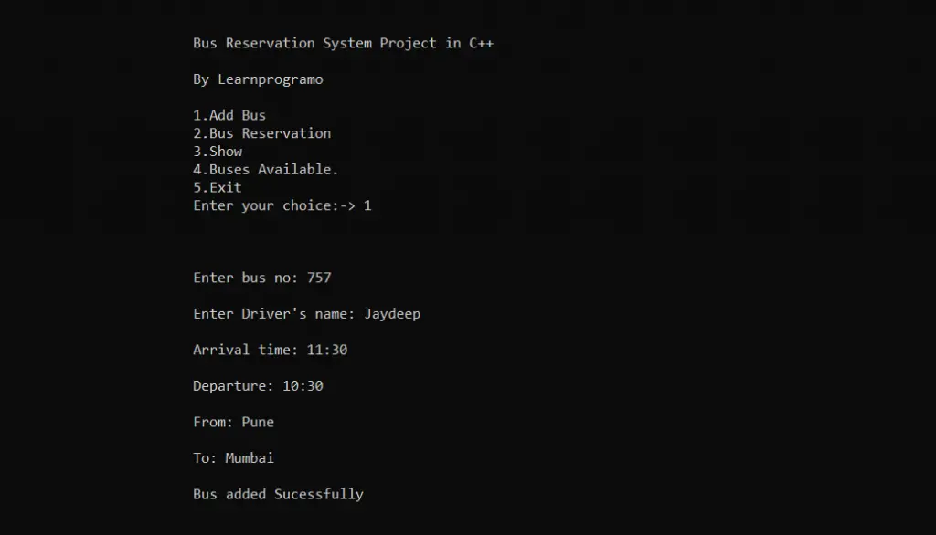
ADD BUS

Slide 10
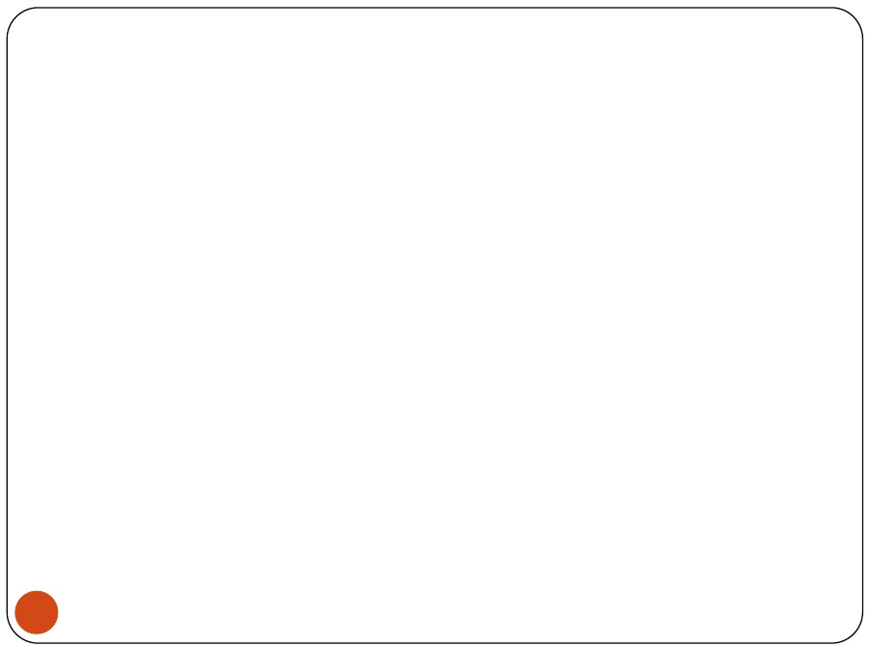
Add Bus:
By choosing this menu option you’ll be able to add the bus which is going to depart from the particular location. To add a new one you have to choose the menu as 1. After choosing the first menu software ask you to enter some details of the bus which are:
The Bus number.
Name of the driver.
Time of Departure.
Arrival Time.
The location from which bus will departure.
Arrival location.
The software will ask you all the above details every time during the addition of a new bus. After entering all the information and successful addition of bus, the software will display one message “Bus added Successfully”. Now in menu option 4, you’ll see the new bus has been added successfully.

Slide 11
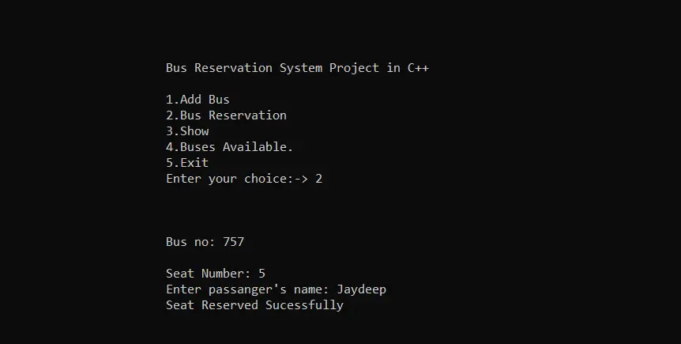
BUS RESERVATION

Slide 12
Bus Reservation: This section is the main section of our project where the passenger will be able to reserve the ticket for the available buses. Before reserving the bus tickets you’ve to choose the 4th option and check whether the bus is available or not. If it’s available then this option comes into the picture. After choosing this option the software will ask for the following information: Bus number. The seat number which you want to book. Name of the passenger. After entering the above information correctly the software will show the success message as “Seat Reserved Successfully”. Note: If the entered seat is reserved by another person already then, the software will show the message as “The seat no is already reserved”. To get rid of this message the next menu comes into the picture. If the seat is already reserved then the software will ask you to enter a different seat, no. If you don’t know which seats are available then, let’s see the working of the 3rd menu.

Slide 13
Show:
With the help of this option, you’ll get a clear picture of the reservation data of a particular bus. After choosing the 3rd option, the software will ask you to enter the bus number for which you want to see the reservation data. Passengers have to enter the bus number in which they want to do the seat reservation.

Slide 14
Buses Available:
With the help of this menu, the passenger will be able to check whether the bus is available or not to which passenger wants to travel. To get all the data of available buses the passenger has to choose the option as 4. After choosing the 4th option the software will display all the data of available buses.

Slide 15
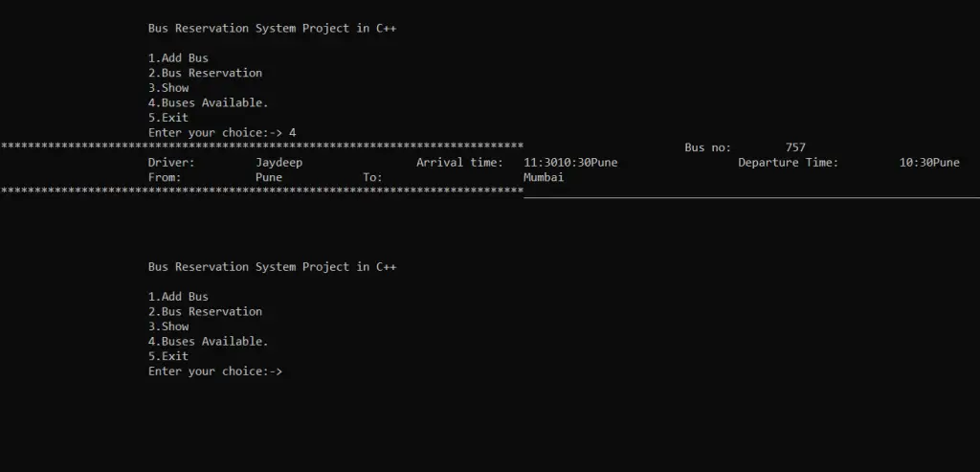

Slide 16
The software will show the following data:
Bus number
Drivers name
Arrival time
Departure time
Departure location
Arrival location
Now let’s see the working of the last menu option of the bus reservation system project in c++ i.e Exit.

Slide 17
Exit:
By choosing the 5th option the bus reservation system project in c++ will be closed.

Slide 18
Summary:
In this way, we’ve created and executed the Bus Reservation System Project in
C++.

Slide 19

THANK YOU………

